Slide 1
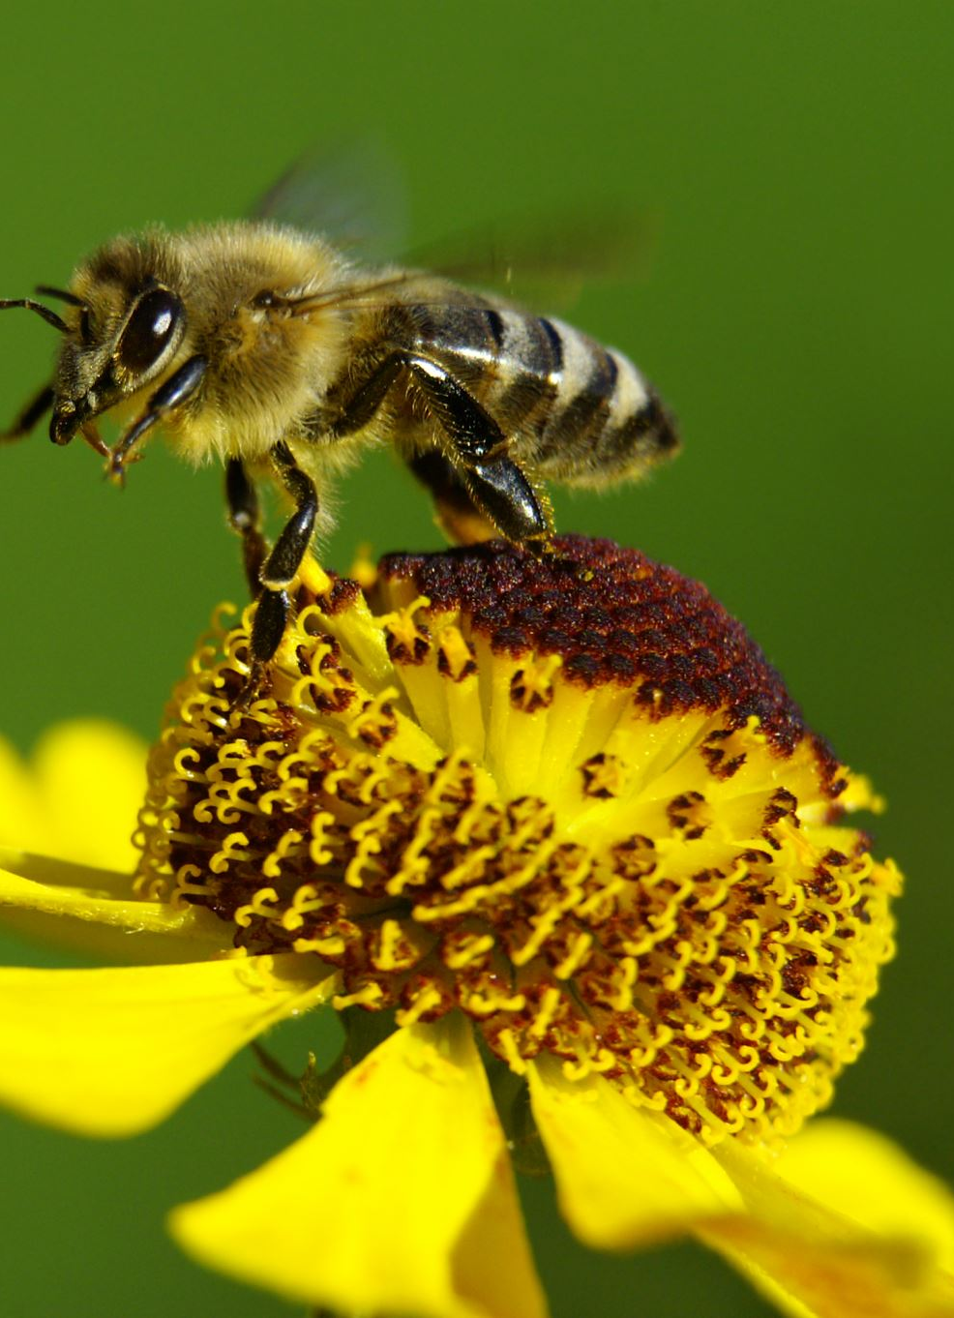
Pollinator abundance survey on WCU Campus
How biodiverse is WCU campus for native plants and pollinators?
What management practices are beneficial to native plants and pollinators?
J. Ted Hillert

Slide 2
Methods Field Literature Review
Surveys monitored pollinator visits to flowers along a four meter transect for two 10-minute intervals per observer
Visit counts are based on number of flowers an individual pollinator visits
A total of 38 observations of 1136 pollination visits by Honeybees, Flies, Wasps, Bumble and Carpenter bees, Small bees, Small butterflies, Large butterflies, beetles, and ants
Reviewed plant-pollination symbiosis in Solidago spp.
Moro et. al 2007

Slide 3
Results
At Contoso, we empower organizations to foster collaborative thinking to further drive workplace innovation. By closing the loop and leveraging agile frameworks, we help business grow organically and foster a consumer-first mindset.​

Slide 4
Management Implications
Annual revenue growth

